Slide 1
Database Design Chat 012
Random versus Scrambled

Slide 2

Louis Davidson (drsql)
https://linktr.ee/drsql

Slide 3
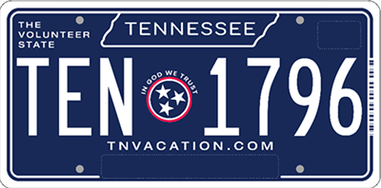
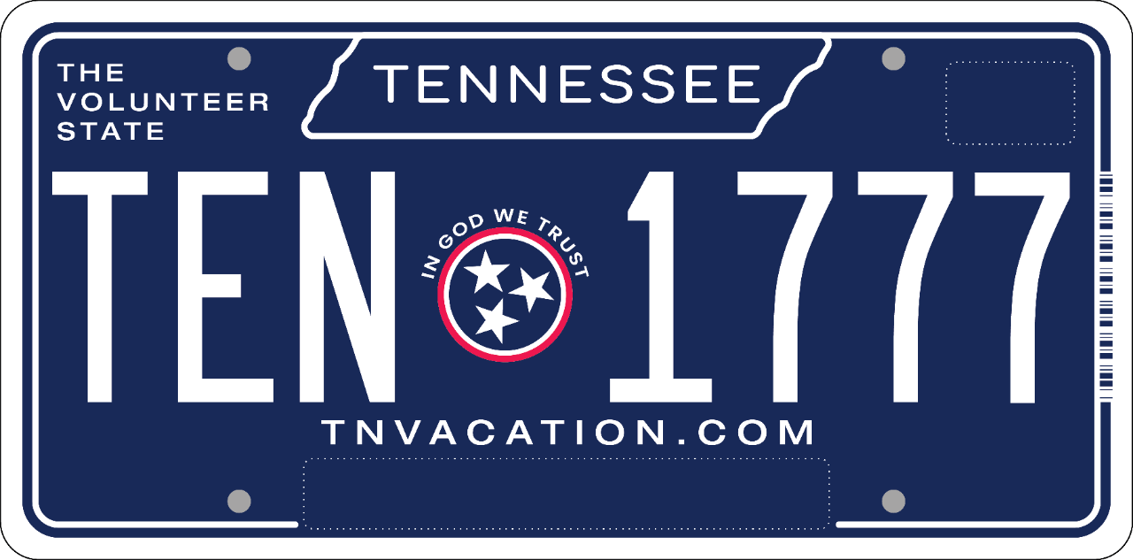
At a stop sign, I saw two cars with VERY similar license plates
Got me to wondering… was this what was really desired?

Slide 4
Random Data versus Scrambled Data
Computers are only as random as you make them
In SQL Server, RAND is described as: Returns a pseudo-random float value from 0 through 1, exclusive. (https://docs.microsoft.com/en-us/sql/t-sql/functions/rand-transact-sql?view=sql-server-ver15)
You can even control the sequence by seeding the generator
GREAT for testing.. Not so great for randomness…
Scrambled data should not be strictly random
It may require patterns and algorithms (such as check digits)

Slide 5
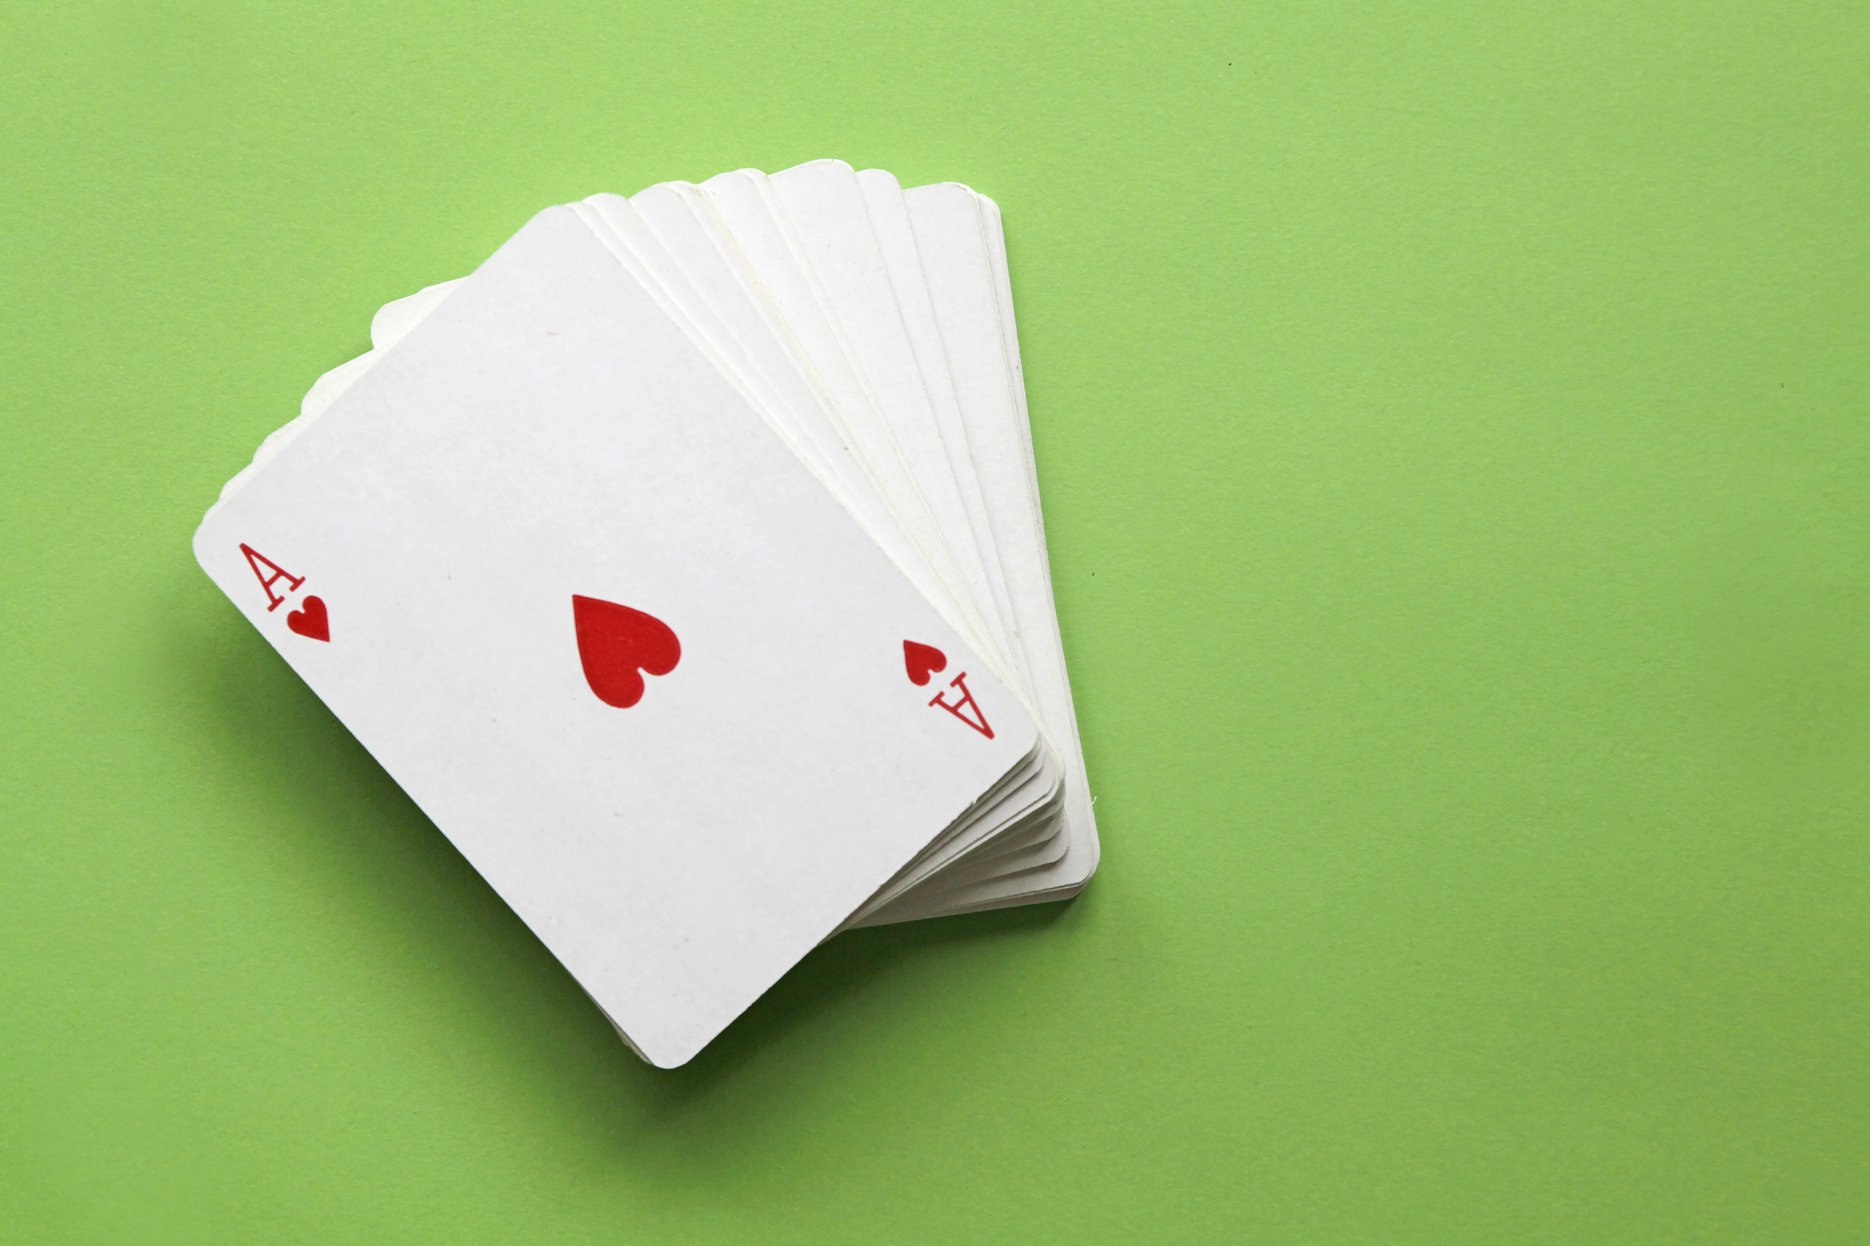
Consider a deck of cards…
True or False or None of the Above
Shuffle a deck of cards
Can the come out in packaged order?
Of course they can…
It is just VERY unlikely
1/52! (1/52 * 51 * … * 3 * 2)

Slide 6
But…
How do you make sure data is
Random
Not distributed in a way you don’t want
Without breaking rules

Slide 7
Computers cheat better than people…
The many many permutations of playing cards is not that much to a computer
Even less so for a database, because you could store and label EVERY useful case
Whether this is allowed or not is a legal matter ☺

Slide 8
Until next time…
Computers are only as random as you program them
Be careful with requirements when it says “Data needs to be RANDOM”
Any set of data can be generated randomly
Up to you (and your requirements) to make sure you give the customer what it really wants…

Slide 9
Questions?
If you have questions, you can:
Comment on YouTube
Email drsql@hotmail.com
Message me on Twitter at drsql
Contact me anywhere on https://linktr.ee/drsql
I may add an episode to discuss or reply directly

